Slide 1
Lecture 2: Ecological Realism
Historical and Philosophical background for ecological psychology

Slide 2
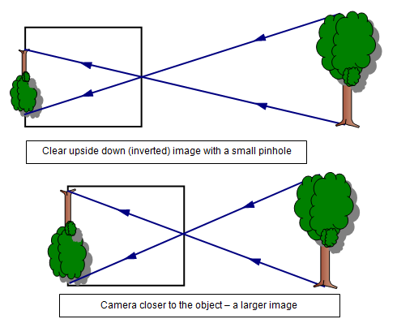
What we see vs. how we see
What do we see (perceive)?
How do we see? The “traditional” way of thinking…
Light → Retinal stimulation → neural impulses → brain computes and constructs a model of the world
Indirect perception – constructivism
Does light necessarily result in perception after it shines on the retina?

Slide 3
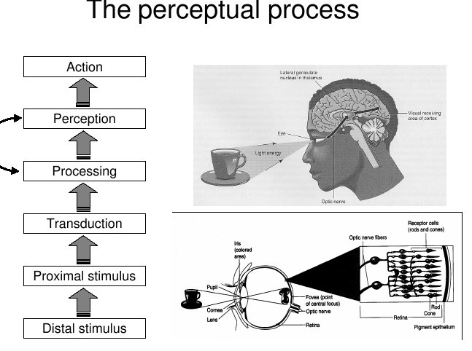
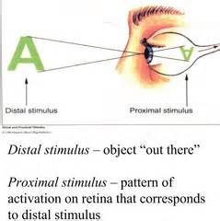
The constructive process of perception

Slide 4
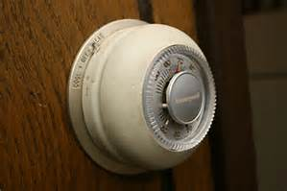
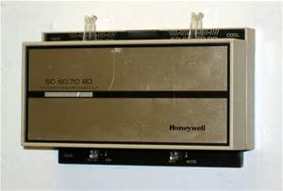

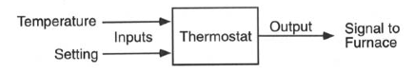
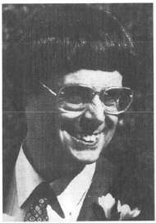
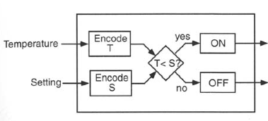
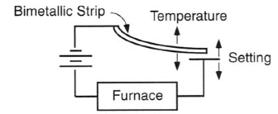
The analogy of Constructivism
David Marr (1982) : Computational theory of vision
L1: Computational Level
L2: Algorithmic Level
L3: Implementation Level

Slide 5
Marr’s Computational Theory
At the computational level, the study of vision focuses on the input and output signals
Input signals = sensory info; but output signals = ?
E.g. intensity difference → contrast → edge
Weber’s law (aka Weber-Fechner law)
Requires the ability to detect edges, which depends on:
Quality of the visual signals
Sensitivity of the eye
Viewing condition etc…

Slide 6
Which is darker?
(130, 130, 130)
(131, 131, 131)

Slide 7
Which is darker?
(130, 130, 130)
(140, 140, 140)

Slide 8
8
7.5
1.5
1

Slide 9
Examples of computational rules of perception
Weber’s law of psychophysics:
The threshold for detecting a stimulus depends on the strength of the stimulus
ΔS/S = k
k→weber ratio, a constant for a type of psychophysical stimuli, e.g. weight, length, brightness etc.
S→ strength of stimulus
ΔS → just noticeable difference, or threshold of detection
Fechner’s law:
P = k ln (S/ΔS)
P → perception (perceived stimulus strength)

Slide 10
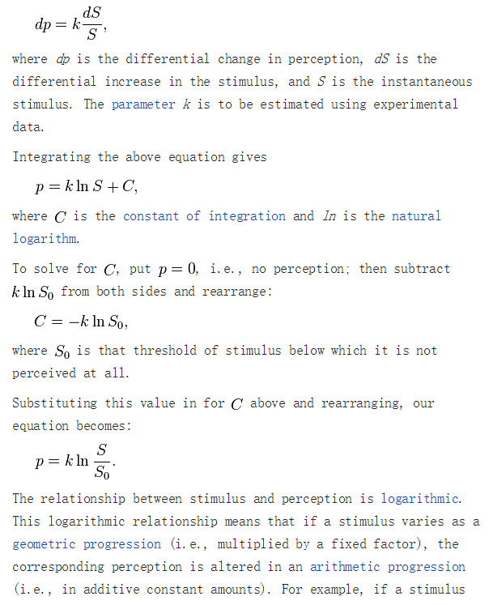
Fechner’s law derivation, Wikipedia.org

Slide 11
Marr’s Computational Theory
At the algorithmic level, the study of vision focuses on how the input signals becomes output signals
Algorithms (= computational rules) are in the brain (born with? Learned?). Algorithms guide the computation of input signals so that they are organized and become output signals
3 x (5+2) = ?

Slide 12
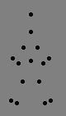
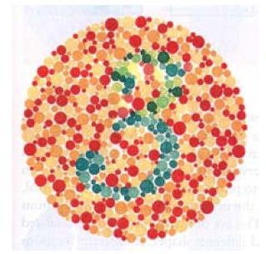
e.g. Gestalt algorithms: law of pragnanz
Can you think of any other “algorithms”?

Slide 13
Marr’s Computational Theory
At the implementation level, the study of vision focuses on the neural mechanisms and their activity that enables the computation.
What happens in the brain that allows the input signals to be detected (computational level) or put together (algorithmic level)?

Slide 14
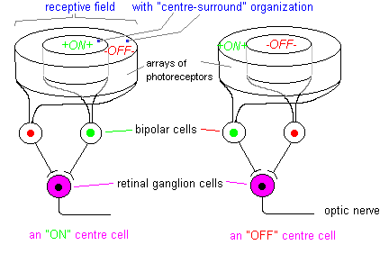
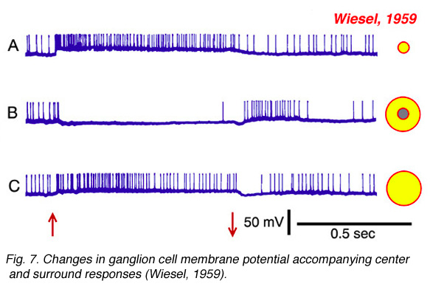

Slide 15
The constructive process of perception
Mental construction
(rule-based)

Slide 16
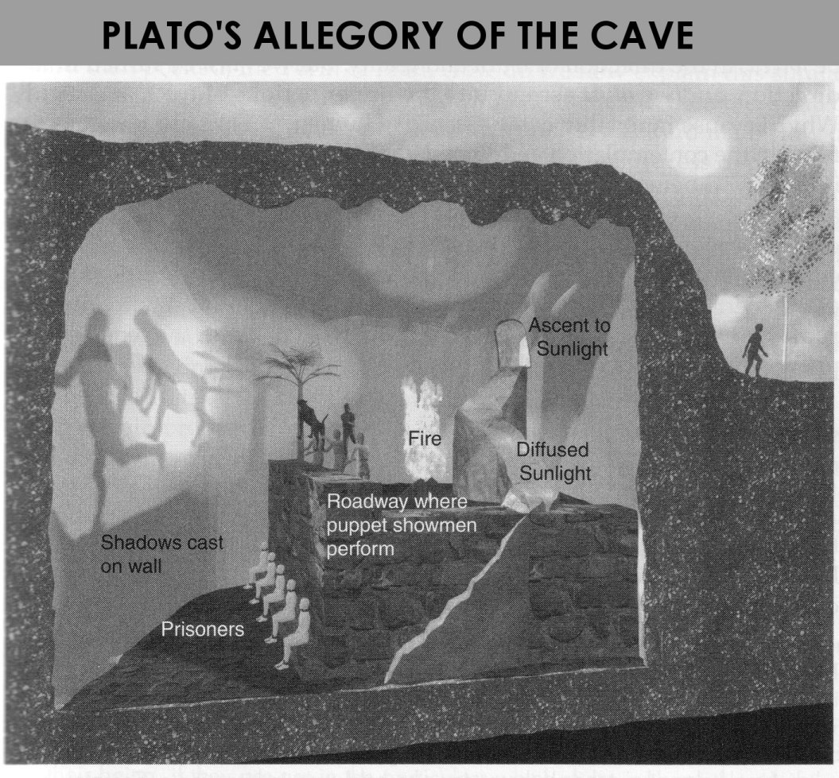
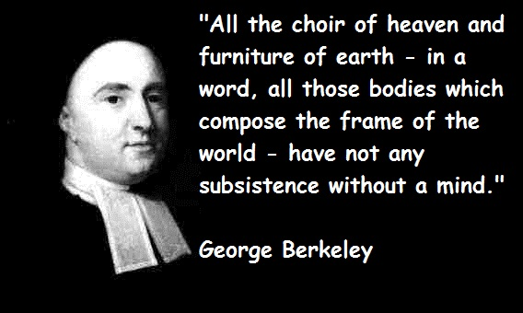
Idealism: things exist as mental constructions Phenomenalism: things exist as we experience them
Plato: allegory of the cave
George Berkeley

Slide 17
Computational vision in sum
What do you perceive?
What is the info for perception?
What are the assumptions？
What is the process of perception?

Slide 18
Counter examples against constructivism

Slide 19
What we see vs. how we see
Do you necessarily “see things”, when the retinal cells are stimulated?
What is the difference between sensation and perception?
Does light results in perception after it shines on the retina?

Slide 21


Slide 22
What we see vs. how we see
Do you necessarily “see things”, when the retinal cells are stimulated?
What is the difference between sensation and perception?
Does light results in perception after it shines on the retina?
Can you perceive something when there is no light reflected from it?
(VEP videos)

Slide 23
What we see vs. how we see
Do you necessarily “see things”, when the retinal cells are stimulated?
What is the difference between sensation and perception?
Does light results in perception after it shines on the retina?
Can you perceive something when there is no light reflected from it?
Are images projected on the retina similar to the actual world objects? (similarity-based representations)

Slide 24
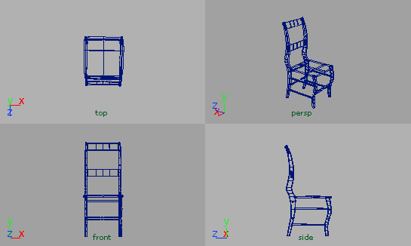
Are images projected on the retina similar to the actual world objects?
Many – to –one mapping
Real Image
objects
Different objects, same image.
Same object, different images.
One – to – many mapping
Real Image
objects

Slide 25
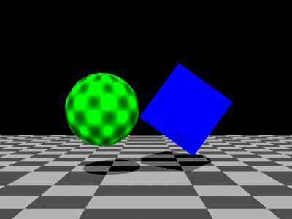
Are images projected on the retina similar to the actual world objects?
What are the shapes that cast these shadows?
What are the shapes? How thick or flat are they? What are their spatial relations?

Slide 26
Are images projected on the retina similar to the actual world objects?

Slide 27
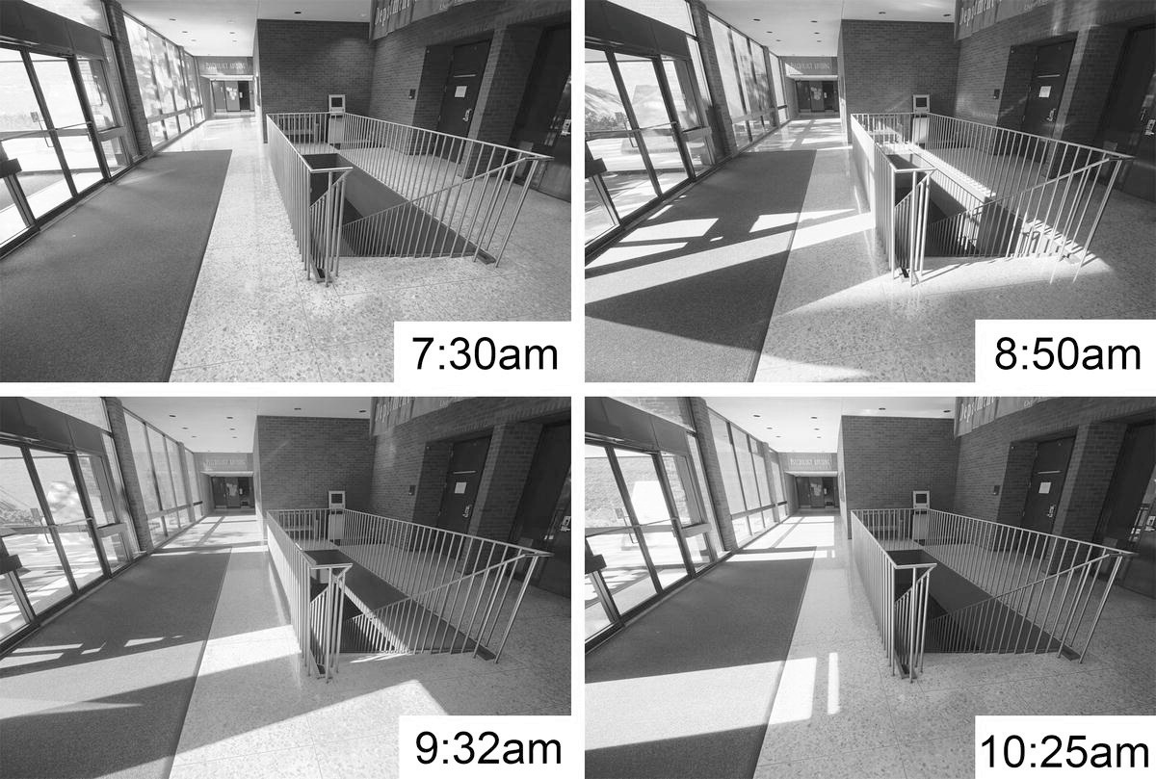

Slide 30
We do not have a world model, that looks like the world itself, on our retinas or in our minds. We do not understand the world by “looking at” its representations in our minds.
But how?
Notes:
If you see the world and then build a world model in your mind. Are you part of the world? Are you part of your mental world model?
Suppose you are in the world. Then you look out – you don’t see you.
Then you build a world model, how do you know where to place yourself in the mental world model?

Slide 31
Realism: things exist whether we experience them or not
Realism and the Scottish Enlightenment. Thomas Reid. 18th century
Reality exists independently of observers or perceptual experiences
Observers live in the world. Observers, world objects and light (as medium) form one unitary system. All elements in the system move, interact and change with time.
What is the status of the system? How do we come to know the status of the system? What is the information that specifies the status of the system?
Central inquiries of a realistic approach to perception
Notes:
Reid believed that common sense (in a special philosophical sense of sensus communis) is, or at least should be, at the foundation of all philosophical inquiry.^{[3]} He disagreed with Hume, who asserted that we can never know what an external world consists of as our knowledge is limited to the ideas in the mind, and George Berkeley, who asserted that the external world is merely ideas in the mind. By contrast, Reid claimed that the foundations upon which our sensus communis are built justify our belief that there is an external world.

Slide 32
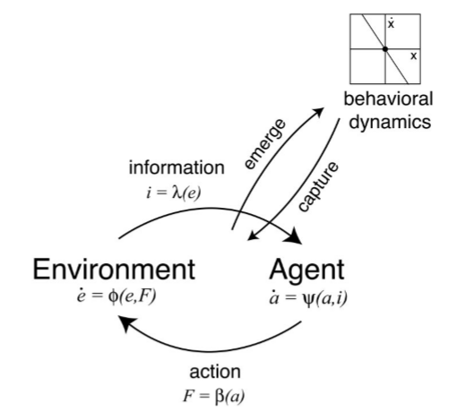
The unitary system of Perception/Action
The P/A system constitutes: observers, objects and light as medium
The system changes over time ( = evolves)
Observers look to acquire info to know (= perceive) the current status of the system
How? – by picking up optical info, which is patterns of light and their changes
Different statuses of the system send out different optical info; different optical info specifies different statuses of the system

Slide 33
Summary: Computational vs. Ecological Approach to Perception
What do we see?
Constructivist/computational: proximal stimuli (retinal images, neural impulses etc)
Eco approach: physical world
How do we see? …
Eco approach: Structured light as info→ perception
Direct perception, from structured light as info to perception
The eyes pick up and the brain measures info.
Computational approach: distal stimuli→ proximal stimuli → sensation → perception
Indirect perception
The eyes detect stimuli, the brain constructs/computes representations

